Slide 1
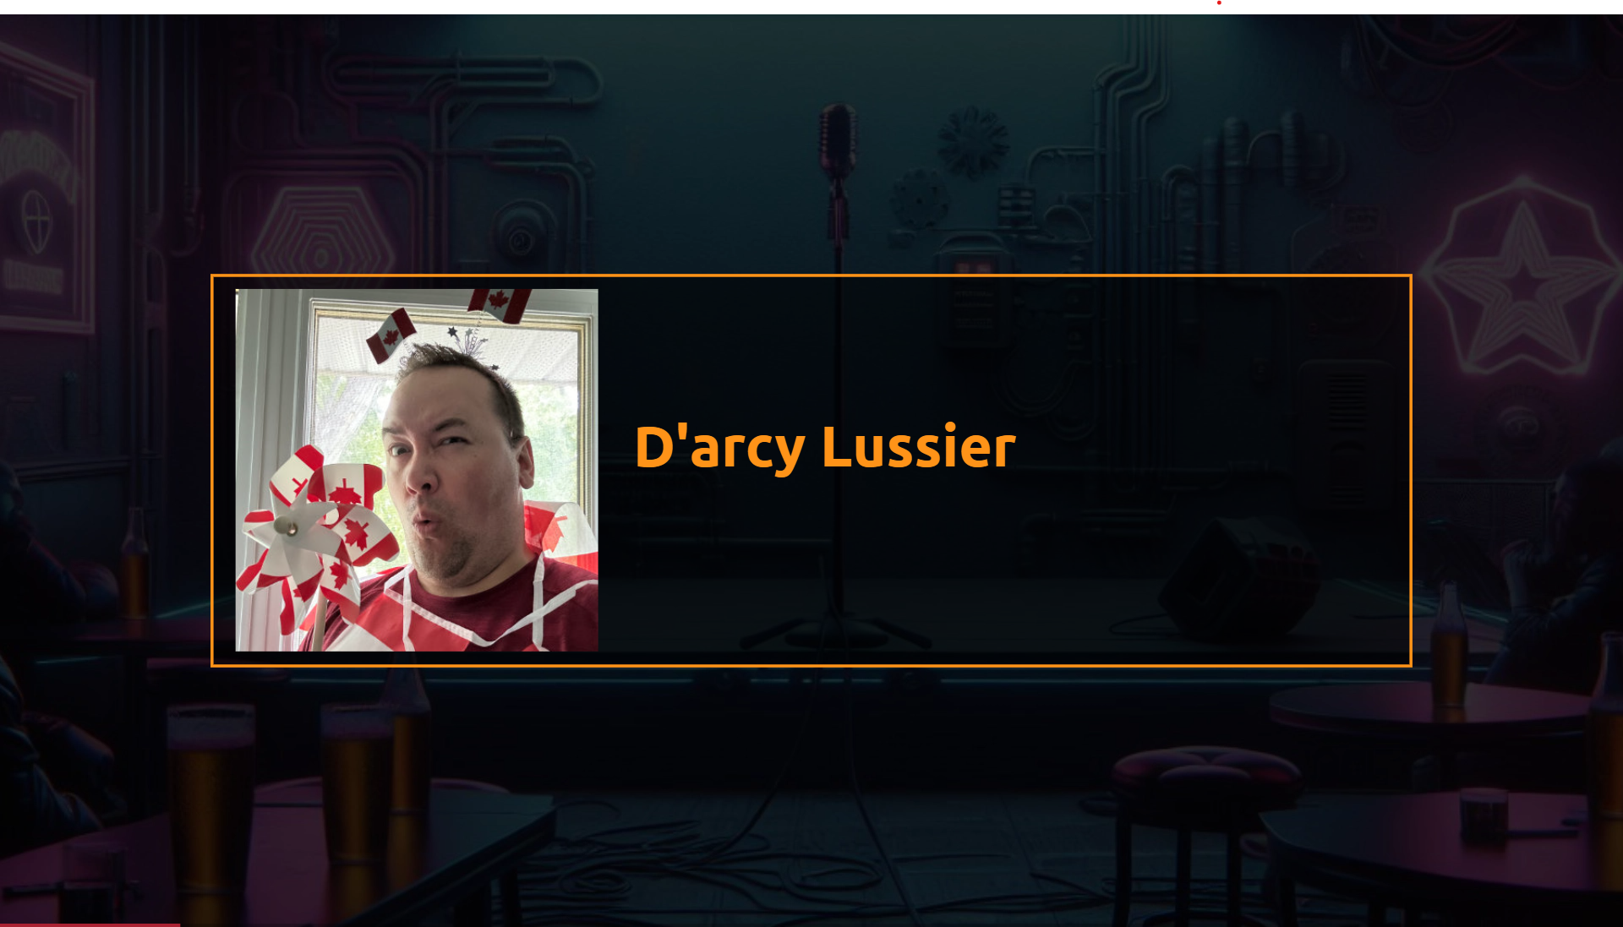

Slide 2
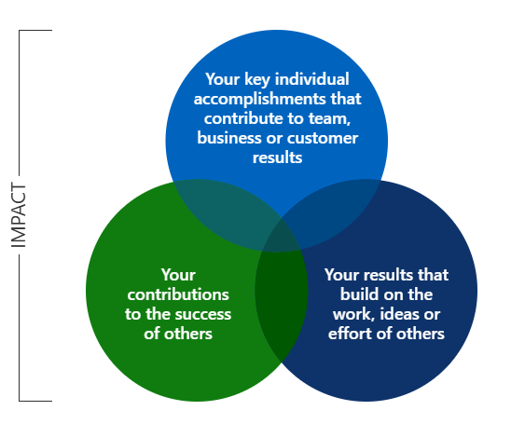
Notes:
At Microsoft we strive to build on the work, ideas and efforts of others. So in that spirit I give you…

Slide 3
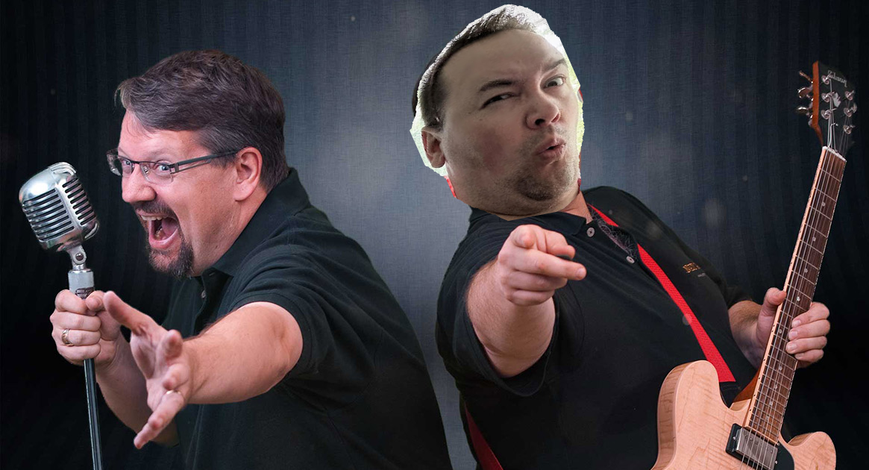
The Next Decade of Software Development
A Commentary to Richard Campbell’s Talk of the Same Name
Notes:
Richard Campbell talked about the next decade, I’m going to add commentary to some of the sound bites.

Slide 4
"A (smart phone is a) personal device that's kept so close it can give you cancer."
Notes:
So I guess a positive of Microsoft consumer products is you’ll never get cancer from them.

Slide 5
"Tim Cook has done a great job putting everything into a single die"
Notes:
The last time something important at Apple was put into a small container was Steve Jobs cremation.

Slide 6
"You can give a tablet to children to keep them quiet."
Notes:
If visiting Missouri has taught me anything, its that a sippy cup with bourbon will work just as well.

Slide 7
"Visual Studio is like the cockpit of a 747"
Notes:
Fitting because it crashes as often as Boeing planes.

Slide 8
"It's got a bad name steeped in science fiction"
Notes:
I don’t know why Richard is so against Khan academy. Why didn’t the javascript dev get a job at Starfleet? They only hire enterprise developers.

Slide 9
"You may like the nub, but you do you"
Notes:
They had to call it a nub because test users couldn’t locate it on the keyboard when it was called a “clitoris”.

Slide 10
“AI is just a term to raise money, it’s a marketing term.”
Notes:
You can’t say “Raise the Microsoft stock price!” without AI.

Slide 11
"Microsoft doesn't know what's going on, they just keep throwing things at the wall ..."
Notes:
Which we know is a strategy that wont’ work in KC based on how it played out for Kareem Hunt.

Slide 12
".NET 9, these versions are getting exhausting"
Notes:
This version will not be popular in Germany. Groans for a German joke? I did Nazi that coming…

Slide 13
"GitHub Copilot - You're the pilot so its still your fault."
Notes:
Someone referred to Copilot as a juvenile developer with limited experience at times and I think its more like an Alaskan air pilot high on shrooms trying to live his best Kobe impersonation. Because just like Kobe, Github Copilot’s code tends to crash…and delete child objects along with the parent.

Slide 14
"5 people know about multi-threaded programming and 4 of them are lying"
Notes:
Kinda like how 5 people said they only took one sandwich each at lunch on Thursday but all 5 of those fuckers lied.

Slide 15
“This is Satya's legacy, he's very invested.”
Notes:
I guess artificial intelligence is a solid second option when your first crack at legacy dies.

Slide 16
“What’s going to disrupt screen and pointer?”

Slide 17
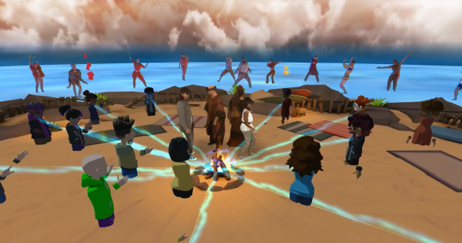
Notes:
I don’t know but I hope its not whatever the fuck this was.

